Slide 1
DATA LOADING INTO SNOWFLAKE

Slide 2
BULK LOADING – Use case (FULL LOAD)
Continuous Load using SNOW PIPE - Use case (CDC)
Loading using the Web Interface – Limited data

Slide 3
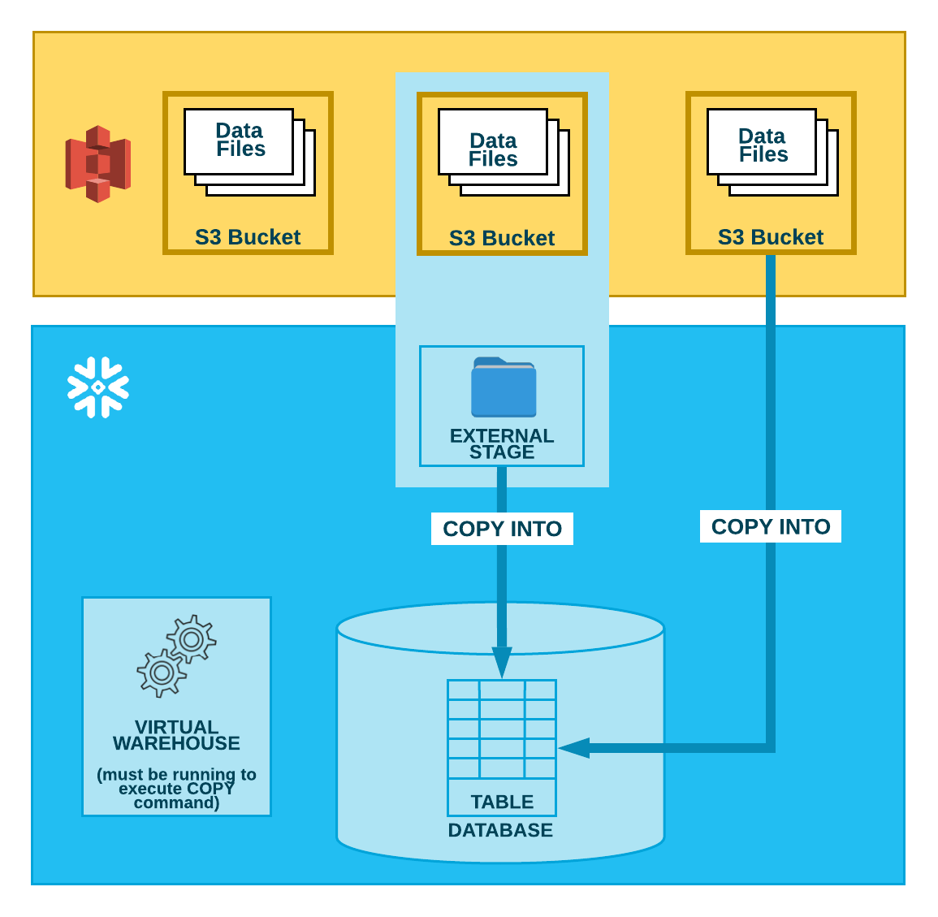
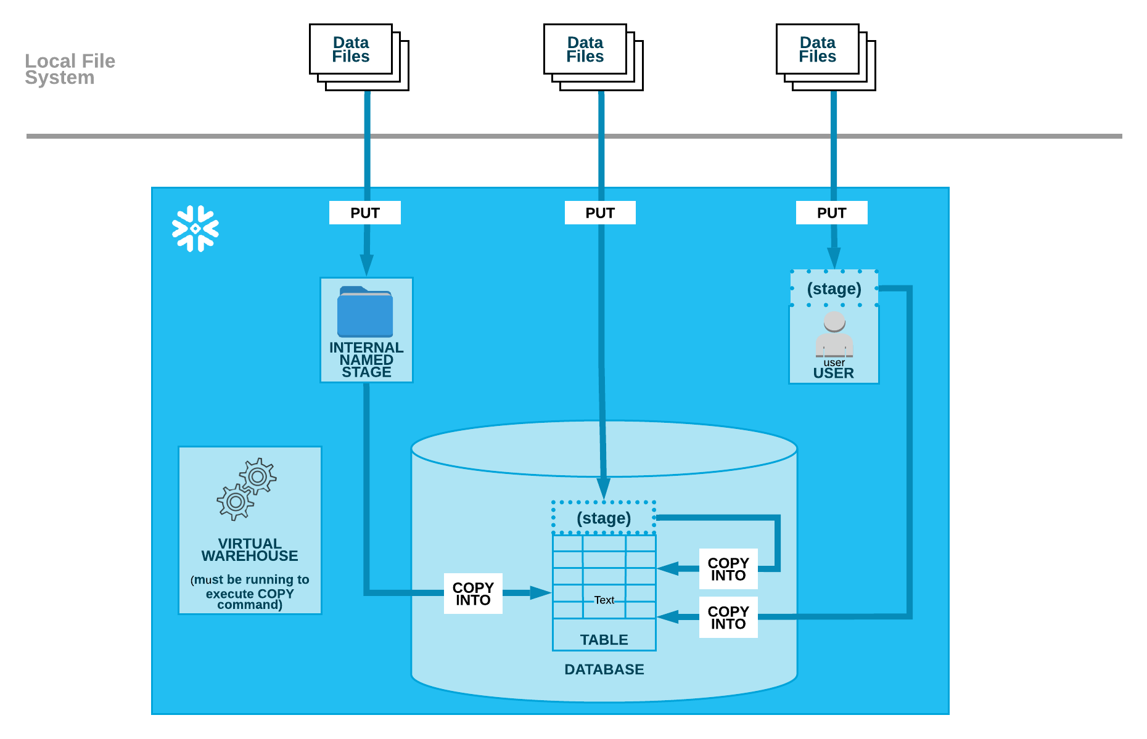
BULK LOADING
FROM CLOUD STORAGE
FROM LOCAL STORAGE

Slide 4
BULK LOADING
Syntax:
COPY INTO [<namespace>.]<table_name>
FROM { internalStage | externalStage | externalLocation }
Compute Resources
Bulk loading relies on user-provided virtual warehouses, which are specified in the COPY statement. Users are required to size the warehouse appropriately to accommodate expected loads.

Slide 5
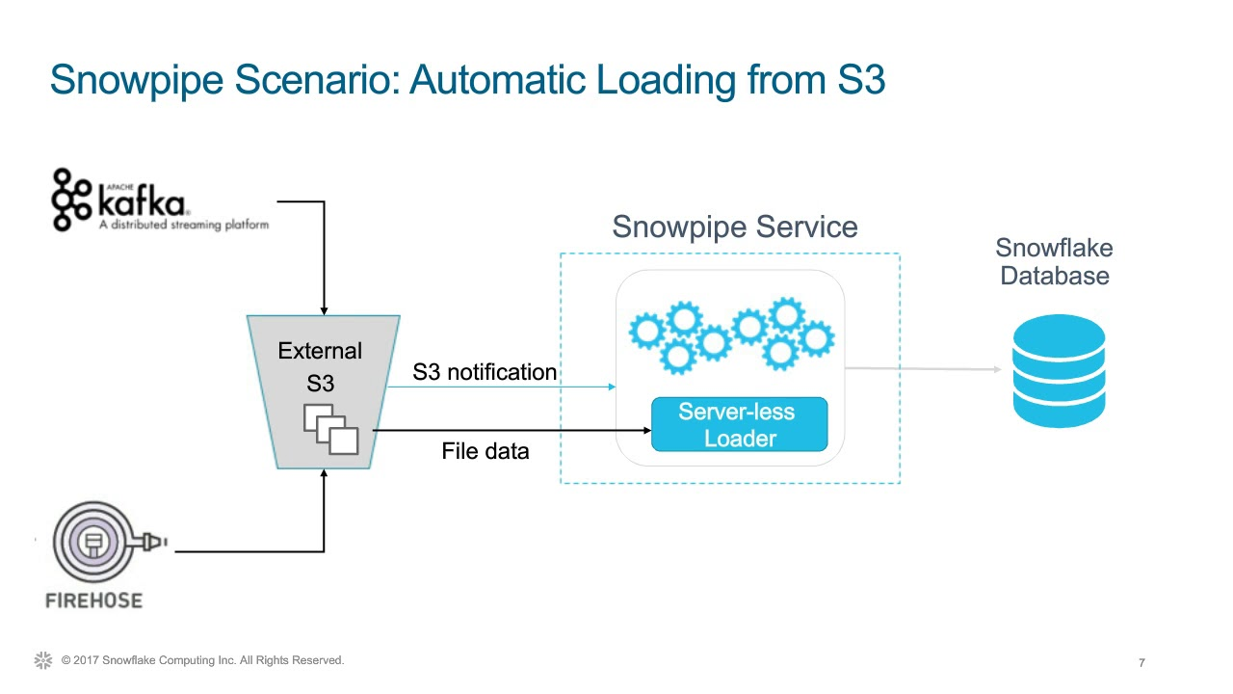
CONTINUOUS LOADING
Snow pipe:
Suitable for small volumes.
Suitable for incremental data loading.

Slide 6
CONTINUOUS LOADING
Snow pipe loads data within minutes after files are added to a stage and submitted for ingestion. This ensures users have the latest results, as soon as the raw data is available.
Compute Resources:
Snow pipe uses compute resources provided by Snowflake (i.e. a serverless compute model). These Snowflake-provided resources are automatically resized and scaled up or down as required.

Slide 7
ALTERNATIVES TO LOAD DATA.
Using external tables.
Suitable when the data is already available in cloud and you are querying only portion of the data (use materialized views)
Actually data will be available only in source(ex : S3)

Slide 8
BULK LOADING FROM EXTERNAL CLOUD STORAGE.
Using Copy with External Location.
COPY INTO DEMO.EMP
FROM s3://snowflake202002/raw_data/
CREDENTIALS=(AWS_KEY_ID = ‘XXXXXX' AWS_SECRET_KEY = ‘XXXXX’)
FILE FORMAT= (TYPE = CSV)
COPY INTO DEMO.EMP
FROM s3://snowflake202002/raw_data/
storage_integration = AWS_S3_SOURCE_DATA
FILE FORMAT=(TYPE= CSV)

Slide 9
BULK LOADING FROM EXTERNAL CLOUD STORAGE.
Using Copy with external stage.
COPY INTO DEMO.EMP
FROM @PUBLIC.stg_S3_Source_data

Slide 10
Snowflake supports transforming data while loading it into a table using the COPY command
Column reordering, Column omission, Datatype casts etc..
Supported File Formats
Structured
Semi-Structured – (JSON, AVRO, PARQUET, ORC, XML)

